Slide 1


PAAVAI COLLEGE OF ENGINEERING Approved By AICTE Government of India | Affiliated to Anna University, Chennai. Department of Artificial Intelligence & Data Science
Driver Drowsiness Detection System
Using Machine Learning
GUIDED BY:
Mr. Prabhu S, M.Tech.,(Ph.D).,
HOD/AI & DS
PAAVAI COLLEGE OF ENGINEERING
NAMAKKAL – 637018.
PRESENTED BY:
PRAKASH S (622021243043)
RATHISWARAN K (622021243045)
HARI KRISHNA K (622021243301)

Slide 2
INTRODUCTION:
In recent years, an increase in the demand for modern transportation necessitates a faster car growth. At present, the automobile is an essential mode of transportation for people.
The automobile has changed people’s lifestyle and improved the convenience of conducting daily activities, it is also associated with numerous negative effects, such as traffic accidents.
Fatigued driving is a significant and latent danger in traffic accidents. In recent years, the fatigue-driving-detection system has become a hot research topic.
Then, these data are used to estimate the vehicles being driven by tired drivers, assisting the drivers to plan their schedules accordingly.

Slide 3
OBJECTIVE:
Driver drowsiness detection is a car safety technology which helps to save the life of the driver by preventing accidents when the driver is getting drowsy.
The main objective is to first design a system to detect driver’s drowsiness by continuously monitoring retina of the eye.
The system works in spite of driver wearing spectacles and in various lighting conditions.
To alert the driver on the detection of drowsiness by using buzzer or alarm.
Speed of the vehicle can be reduced.
Traffic management can be maintained by reducing the accidents

Slide 4
ABSTARCT:
The face, an important part of the body, conveys a lot of information. When a driver is in a state of fatigue, the facial expressions, e.g., the frequency of blinking and yawning, are different from those in the normal state.
In this study, we propose a computer vision based method to detect driver’s drowsiness from a video taken by a camera. The method attempts to recognize the face and then detecting the eye in every frame.
Further, we designed a new detection method for facial regions based on 68 key points. Then we use these facial regions to evaluate the drivers' state.
By combining the features of the eyes and mouth, we can alert the driver using a fatigue warning with the alarm sound.

Slide 5
EXISTING SYSTEM:
The paper's motive is to demonstrate the implementation of a driver’s drowsiness detection using MATLAB through image processing.
Studies suggest that about one-fourth of all serious road accidents occur because of the vehicle drivers' drowsiness where they need to take, confirming that drowsiness gives rise to more road accidents than accidents occur through Drink and Drive.
Drowsiness Detection System is designed by employing vision-based concepts. The system’s main component is a small camera pointing towards the driver's face scan and monitoring the driver's eyes to detect drowsiness
There are various methods like detecting objects which are near to vehicle and front and rear cameras for detecting vehicles approaching near to vehicle and airbag system which can save lives after an accident is accorded.

Slide 6
PROBLEM STATEMENT:
Fatigue is a safety problem that has not yet been deeply tackled by any country in the world mainly because of its nature. Fatigue, in general, is very difficult to measure or observe unlike alcohol and drugs, which have clear key indicators and tests that are available easily.
Most of the existing systems use external factors and inform the user about the problem and save users after an accident is accord but from research most of the accidents are due to faults in users like drowsiness, sleeping while driving.
These methods can’t able to detect the facial expressions, yawning head nods, and majorly on eye blink frequencies.
Accuracy of the existing method is not good when comapred to the proposed model

Slide 7
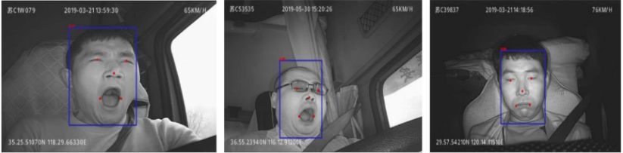
PROPSOED SYTEM:
Visual object tracking
Facial landmarks recognition & Driver drowsiness detection
Determination of eyes and mouth regions : The region of the eyes, Evaluation of the driver’s fatigue state
Eye status recognition: (Recognition based on CNN and recognition based on angle)
Mouth status recognition , Alarm Sound & Self Mode alert

Slide 8
TECHNOLOGY USED:
PYTHON - Python is an interpreted, high-level, general-purpose programming language. Python's design philosophy emphasizes code readability with its notable use of significant whitespace.
VS Code IDE- created to develop open-source software, open-standards, and services for interactive computing across dozens of programming languages.
IMAGE PROCESSING - In computer science, digital image processing is the use of computer algorithms to perform image processing on digital images.
MACHINE LEARNING - Machine learning is the scientific study of algorithms and statistical models that computer systems use in order to perform a specific task effectively without using explicit instructions, relying on patterns and inference instead.

Slide 9
ADVANTAGES:
This method will detect a problem before any problem accord and inform the driver and other passengers by raising an alert.
In this OpenCV based machine learning techniques are used for automatic detection of drowsiness.

Slide 10
What is open cv ?
OpenCV Python is nothing but a wrapper class for the original C++ library to be used with Python.
Using this, all of the OpenCV array structures gets converted to/from NumPy arrays.
This makes it easier to integrate it with other libraries which use NumPy. For example, libraries such as SciPy and Matplotlib.
It can process images and videos to identify objects, faces, or even the handwriting of a human.

Slide 11
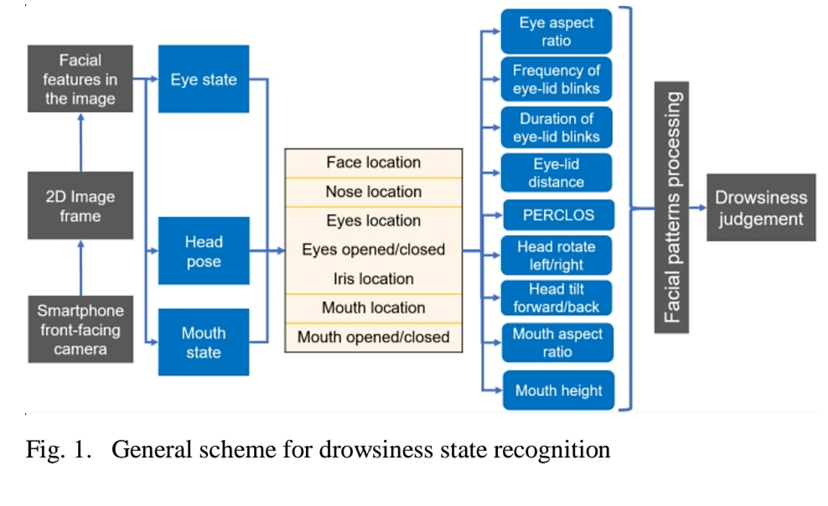
BLOCK DIAGRAM:
camera

Slide 12
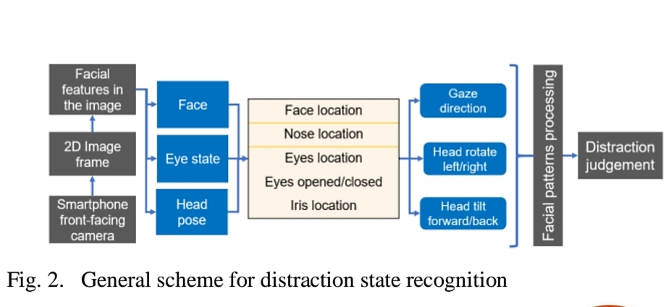

Slide 13
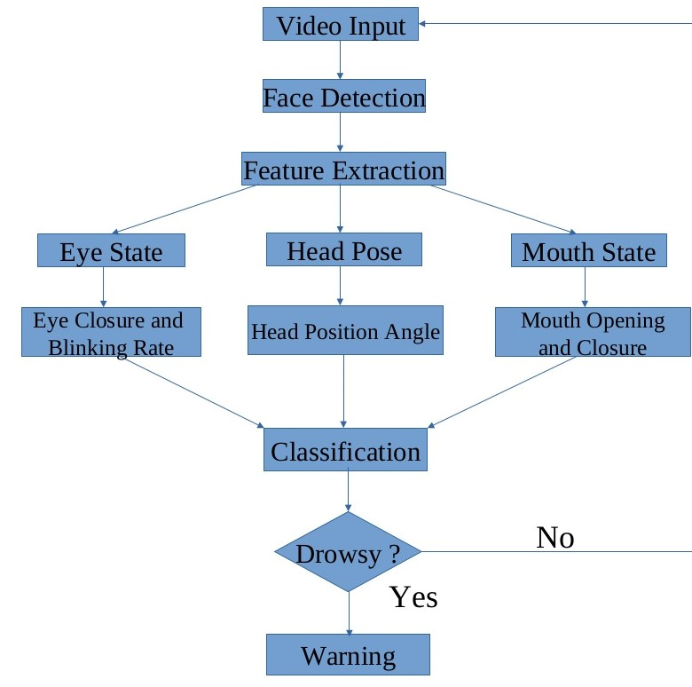
FLOW DIAGRAM:

Slide 14
HOG ALGORITHM:
Initially, the faces are detected using a Haar Cascade Classifier on an image in conjunction with the cropping of the cardinal section of the face.
The H.O.G(Histogram of Oriented Gradients) is a feature descriptor used in computer vision for image processing for the purpose of object detection.
HOG, or Histogram of Oriented Gradients, is a feature descriptor that is often used to extract features from image data. It is widely used in computer vision tasks for object detection.
This is done by extracting the gradient and orientation (or you can say magnitude and direction) of the edges.

Slide 15
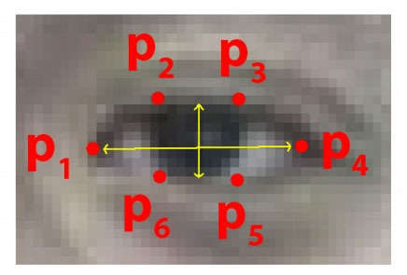
The eye aspect Ratio is an estimate of the eye opening state. Based on Figure 2, the eye aspect ratio can be defined by the below equation.
A program can determine if a person's eyes are closed if the Eye Aspect Ratio falls below a certain threshold

Slide 16
SOFTWARE REQUIREMENTS
Operating system: Windows 7(Basic)
Coding Language: python
Libraries Used
Numpy
Scipy
Playsound
Dlib
Tensorflow
opencv, Matplotlib, etc.
Tool: pycham

Slide 17
HARDWARE REQUIREMENTS:
Processor : Pentium processer of 400 MHz or higher.
RAM : minimum 64MB primary memory
Hard disk : minimum 1 GB hard disk space.
Monitor : preferable color monitor (16 bit color) and above.
Web camera
Compact disk drive
A keyboard and mouse.

Slide 18
EYE ASPECT RATIO:
The Eye Aspect Ratio is an estimate of the eye opening state.
the eye aspect ratio can be defined by the below equation. ... A program can determine if a person's eyes are closed if the Eye Aspect Ratio falls below a certain threshold.
Clmtrackr is another facial landmark plotter
FORMULA
EAR= ||P2-P6||+||P3-P5||
2||P1-P4||

Slide 19
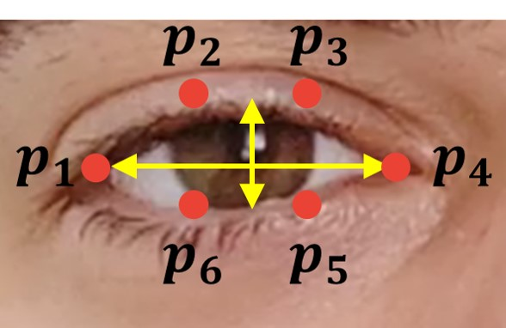
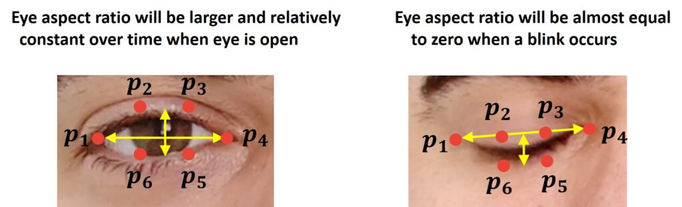

Slide 20
FACIAL LANDMARK:
Facial Landmark- It is a inbuilt HOG SVM classifier used to determine the position of 68(x, y) coordinates that map to facial structures on the face
It is mainly used for image or video processing and also analysis including object detection, face detection, etc.
Facial landmarks are used to localize and represent important regions of the face, such as: · Mouth. · Eyes. · Eyebrows.

Slide 21
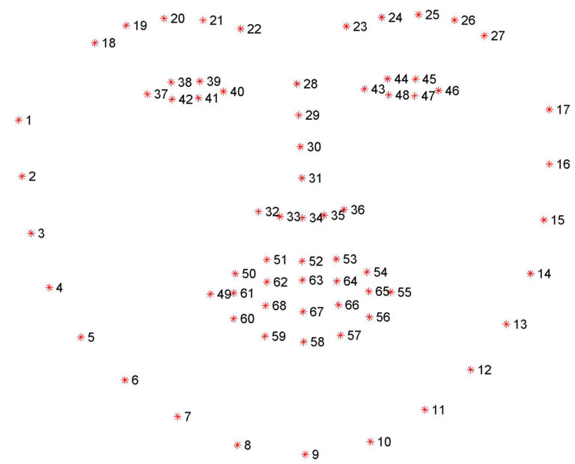
FACIAL LANDMARK:

Slide 22
MAR (MOUTH ASPECT RATIO):
Using this concept, we have calculated the Mouth Aspect Ratio: Representing the face with 68-(x,y) coordinates.
As we see that the mouth is represented by a set of 20-(x,y) coordinates.
So, we have used coordinates 62, 64, 66, and 68 to calculate the distance between then in the same way as EAR Calculation.
MAR = |CD| + |EF| + |GH|
3 * |AB|

Slide 23
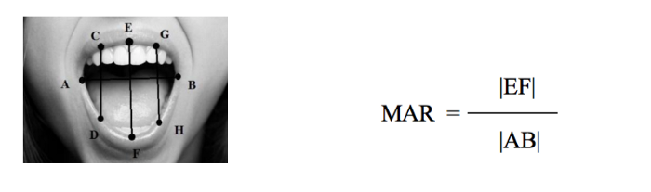
Diagram:

Slide 24
RESULTS AND DISCUSSION:
The driver anomaly observing framework created is able of identifying laziness, intoxicated and careless practices of driver in a brief time.
The Laziness Detecting Framework created based on eye closure of the driver can separate ordinary eye flicker and tiredness and distinguish the laziness while driving.
During the monitoring, the system is able to figure out if the eyes are opened or closed.
When the eyes have been closed for too long, a warning sign is issued. processing judges the driver’s alertness level on the groundwork of continuous eye closures

Slide 25
As a result beep sound is heard when the driver yawn and closes the eye lid. This helps to alert the driver.
Also self driving mode starts when the driver eye is closed for more than 60 seconds.

Slide 26
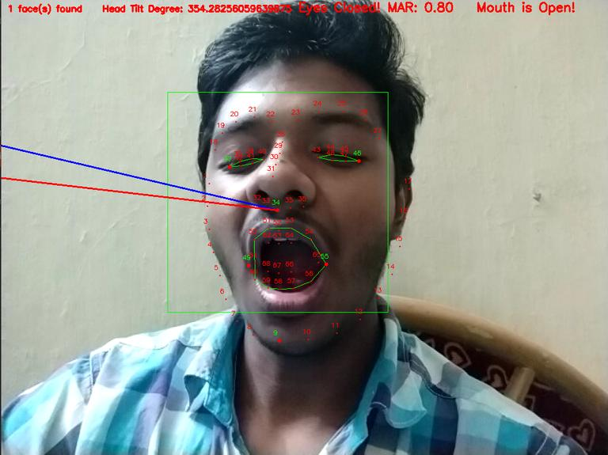
Result(Attached your own output):

Slide 27
CONCLUSION:
The driver anomaly observing framework created is able of identifying laziness, intoxicated and careless practices of driver in a brief time.
The Laziness Detecting Framework created based on eye closure of the driver can separate ordinary eye flicker and tiredness and distinguish the laziness while driving.
The suggested device is able to avoid the incidents when driving due to sleepiness.
The system works properly even in case of drivers sporting spectacles and even below low light stipulations if the digital camera offers higher output.
processing judges the driver’s alertness level on the groundwork of continuous eye closures

Slide 28
Future scope:
The model can be improved incrementally by using other parameter blinking rate ,state of the cars , etc.
If all these parameter are used it can improve the accuracy by lot.
We plan to future work on the project by adding a sensor to o track the heart rate in order to prevent the accident caused due to sudden heart attack to driver.
Same model and techniques can be used for various other uses like Netflix and other streaming services can detect when is asleep and stop the video accordingly .
It can also be used in application that prevent user from sleeping

Slide 29
REFERENCE PAPERS:
Jagbeer Singh, Ritika Kanojia, Rishika Singh, Rishita Bansal, Sakshi Bansal, Computer Science and Engineering Dept, Meerut Institute of Engineering and Technology, Meerut, India DOI: 10.47750/pnr.2022.13.S10.361
Dr. R. Kayalvizhi Assistant Professor, Dept. of Computer Science & Engineering SRM Institute of Science & Technology, Kattankulathur Chennai, India-603203 603203ISSN, Published by: www.ijert.org , Vol. 10 Issue 05, May-2021
Biswarup Ganguly, MIEEE Department of Electrical Engineering Jadavpur University Kolkata- 700032, India IEEE VLSI Device, Circuit and System Conference 2022 (IEEE VLSI DCS 2022), 26-27 February 2022, IEEE ED MSIT SBC, Kolkata, India

Slide 30
THANK YOU

